Slide 1
Supervisor Meeting
G3T2
16-October 2014
Yuan Yuxuan
Max Chua
Aayush GARG
Eva Tan
Wu Di

Slide 2
Agenda
Progress for past two weeks
  Iteration 3
    Heatmap
    Basic Location Report
Deviation from plan
Goals
  Functionalities
Problem
Roles
Metric

Slide 3
Progress thus far
Iteration 3: (29/09/2014 – Present)
  Preparation for Heuristic Evaluation
  Heat Map
  Basic Location Report
  Continue Testing for all functionalities
Progress for past weeks
Deviation from plan
Goals next iteration
Problem
Roles
Metric

Slide 4
Deviations from plan
Main Task | Basic Location Report
Time delayed | 5 Days behind 9.3 extra coding hours
Reasons | Change of the requirement Underestimate the difficulty of the functionality
Result | Successfully coded and deployed heatmap
Effect | Drag down the overall schedule Time leave for testing not enough. (Cannot have a fully testing, will continue in the following iterations.)
Progress for past weeks
Deviation from plan
Goals next iteration
Problem
Roles
Metric

Slide 5
Deviations from plan
Main Task | Displaying Heatmap
Time delayed | 7 days behind
Reasons | Learning the concepts behind the display of heatmap Tried various approaches (d3, heatmap.js) but failed
Result | Successfully coded and deployed heatmap
Progress for past weeks
Deviation from plan
Goals next iteration
Problem
Roles
Metric

Slide 6
Goals next iteration
Functionality: Coach: Yuxuan & Max
  Automatic Group Identification
    Eva and Yuxuan
  Web service and JSON
    Max and Aayush
  Administrator file upload
    Max and Aayush
Better project management
  Better time estimation
  More even distribution of coding hours
Progress for past weeks
Deviation from plan
Goals next iteration
Problem
Roles
Metric

Slide 7
Problem
Time taken to debug:
  Delays on further iteration depends on time taken to debug heat map and basic location report
Potential:
  Automatic Group Identification taking longer than expected
Progress for past weeks
Deviation from plan
Goals next iteration
Problem
Roles
Metric

Slide 8
Roles
Iteration 3
  Project Manager: Yuan Yuxuan
  Coach: Max and Yuan Yuxuan
  Heat Map: Max & Eva
  Basic Location Report: Aayush & Wu Di
Progress for past weeks
Deviation from plan
Goals next iteration
Problem
Roles
Metric

Slide 9
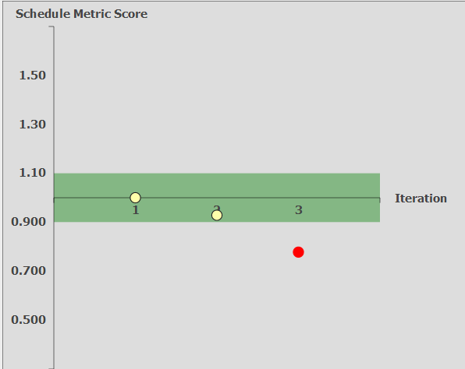
Metric – Schedule Metric
Progress for past weeks
Deviation from plan
Goals next iteration
Problem
Roles
Metric

Slide 10
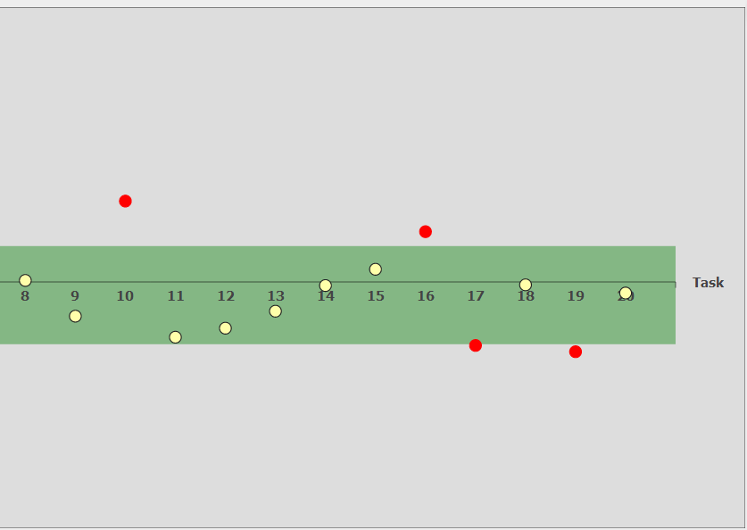
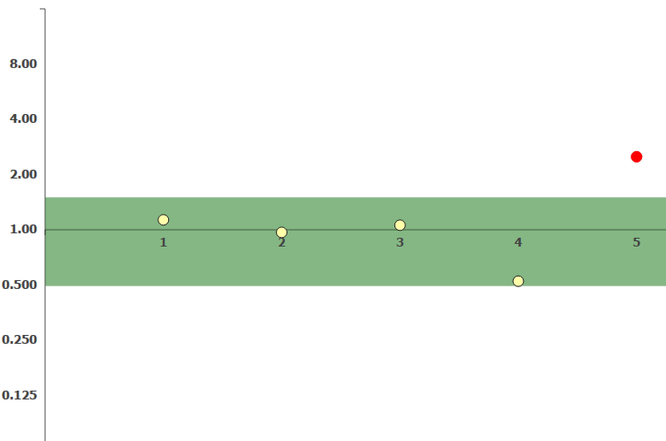
Metric – Pair Programming Metric
Progress for past weeks
Deviation from plan
Goals next iteration
Problem
Roles
Metric

Slide 11
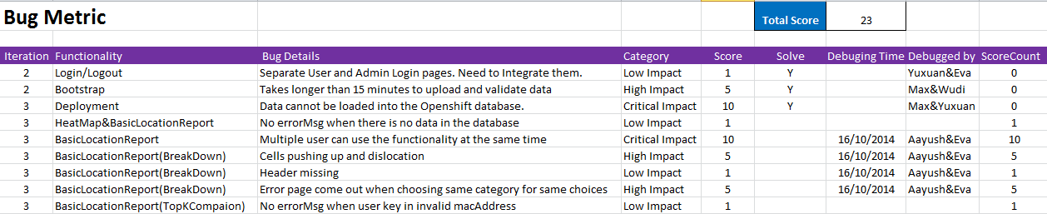
Metric – Bug Metric
Progress for past weeks
Deviation from plan
Goals next iteration
Problem
Roles
Metric

